Slide 1
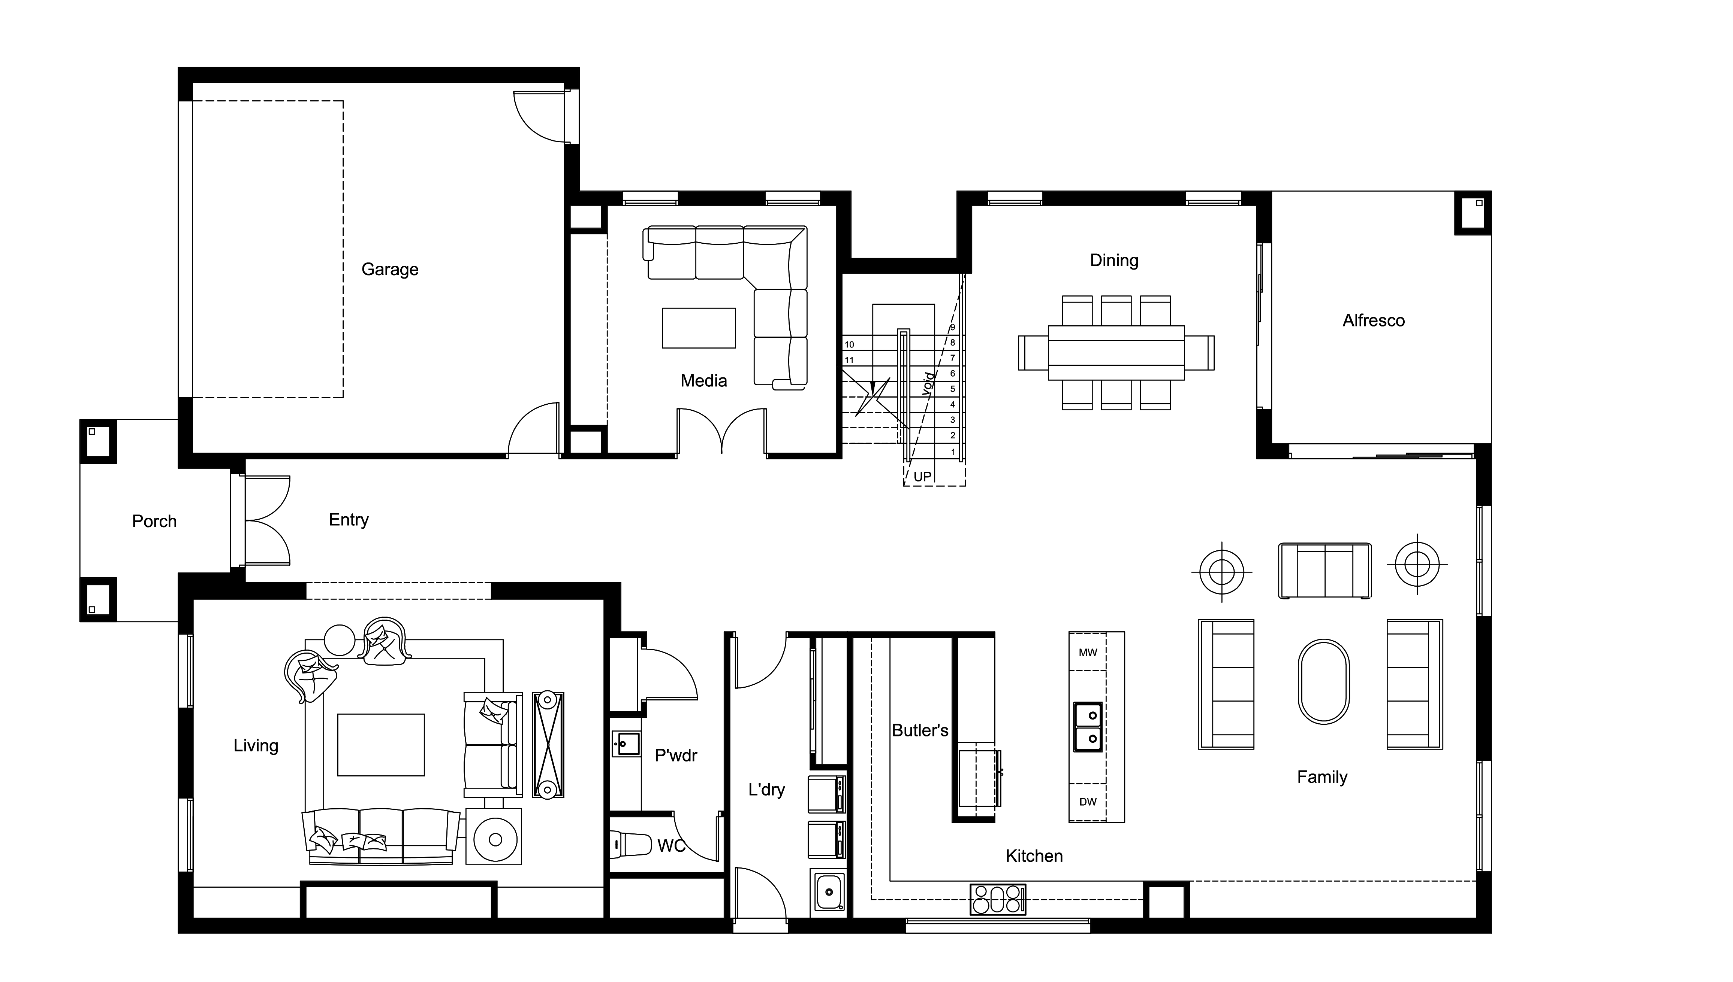
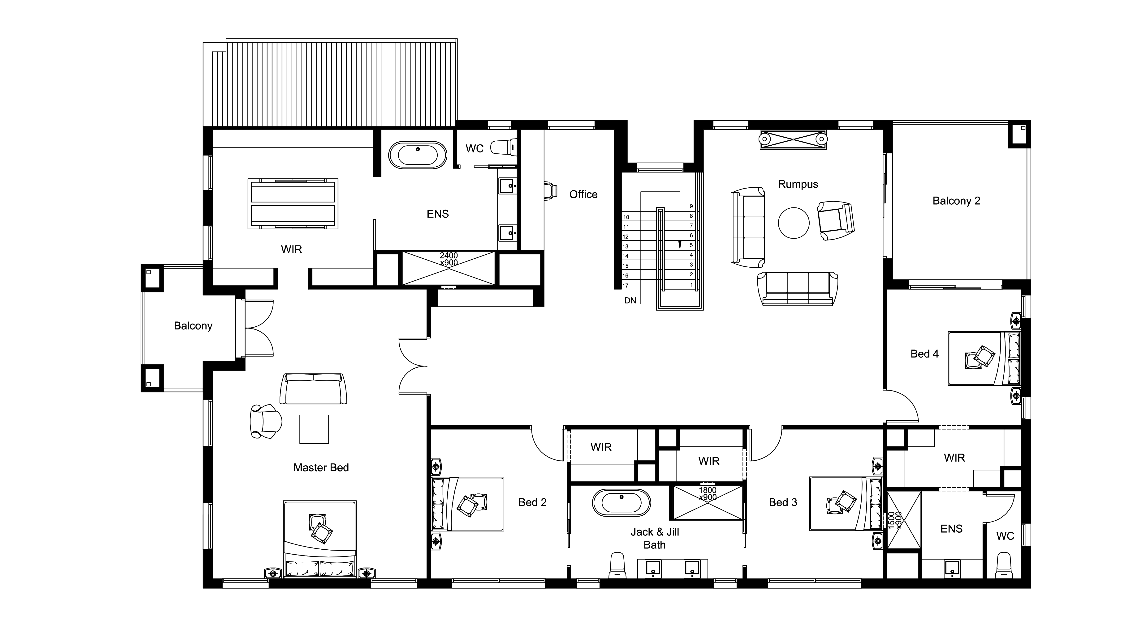
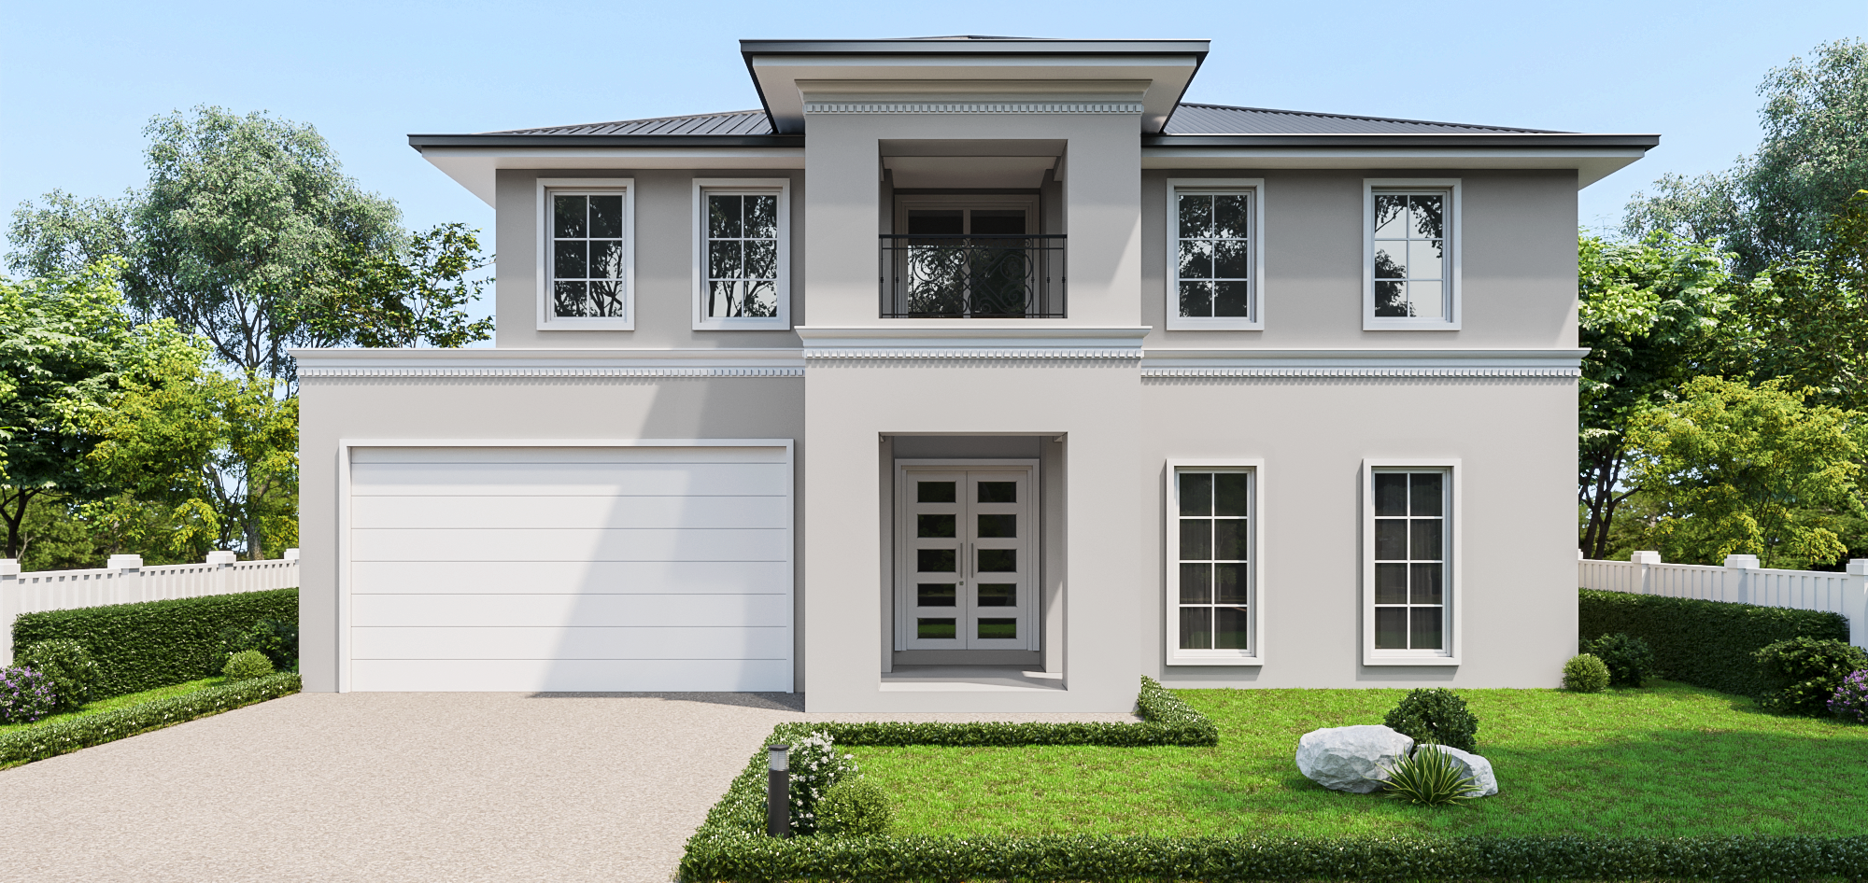
House and Land Package $1,950,000
Bedroom 4 | Bathroom 3 | Garage 2
THE BORDEAUX 56- ANNETTE FACADE
Lot 325 - Kingbird
Land Size: 512m²
Frontage: 16m
Inclusions
Maximum 500mm Cut and Fill based on a 600m2 block of land.
Colourbond roofing
Ducted reserve cycle Air-conditioning
Laser level ceilings to main living area
40mm Constituted Stone Benches throughout
SMEG 900mm wide stainless-steel oven and gas cooktop
SMEG stainless steel dishwasher
Stainless steel double bowl undermount sink to the Kitchen.
Water point for fridge connection
LED diffused downlights throughout the home.
Freestanding bath selected from the Nira Gallerie Design Range
Rimless wall back to wall toilet selected from the Nira Gallerie Design Range
Framed mirrored sliding doors to Bedroom robes
Tiled shower niches to all showers 400mm x 400mm
Contact our team for a full list of inclusions
Builder: Henry Day
Phone: 0411 177 813
Land Agent: Heather
Phone: 0488 972 712
* Photos & illustrations are representative only and may include optional features. House and land sold separately & subject to availability. Nira Homes reserves the right to change prices or expire the current promotion without notice. The Purchaser is aware it is their responsibility to make independent enquiries into restrictions on the property in relation to Developer Guidelines, Building Envelopes and Plan of subdivision before purchasing the land. Proposed home & land package is subject to engineering plans & developer’s approval & may need to be altered to comply with estate covenants and may affect pricing.

