Slide 1
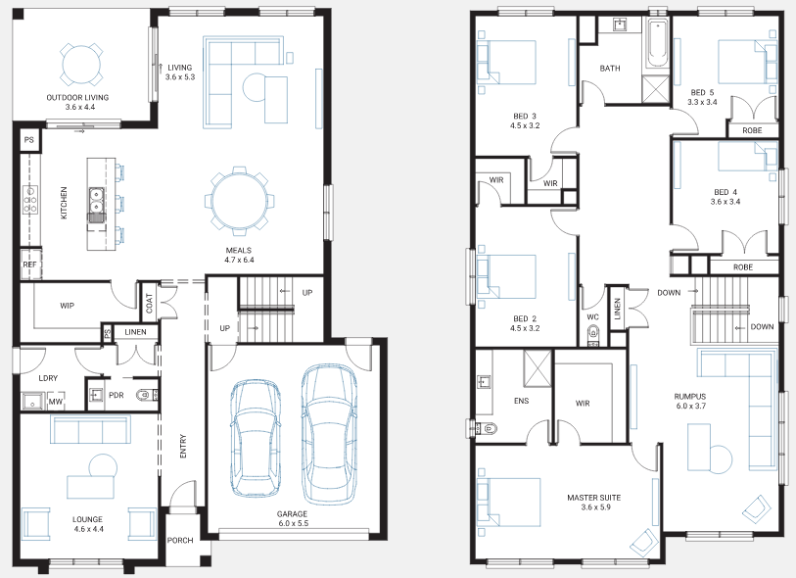
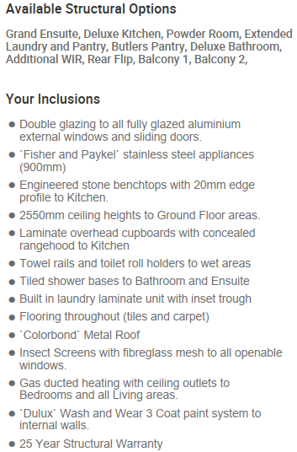
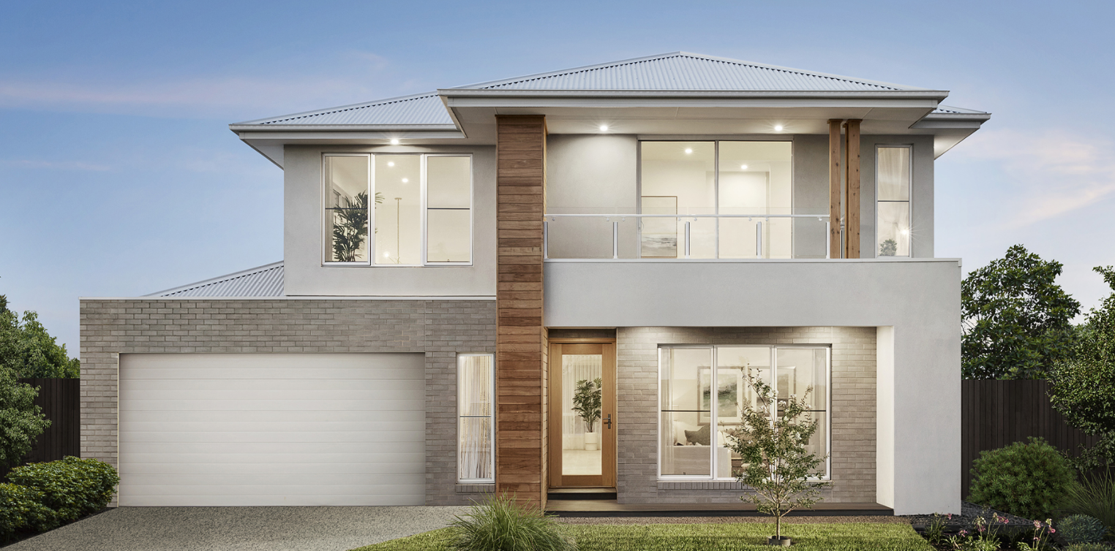
House and Land Package $983,100*
Bedroom 4 | Bathroom 2 | Garage 2
Jarrah 35
Lot 324 - Kingbird
Land Size: 448m²
Frontage: 14m
Builder: Beachwood Homes
Phone: 0409 449 841

