Slide 1
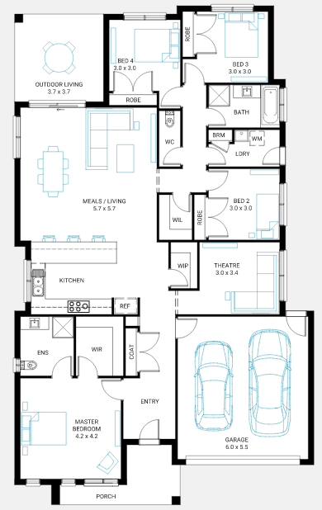
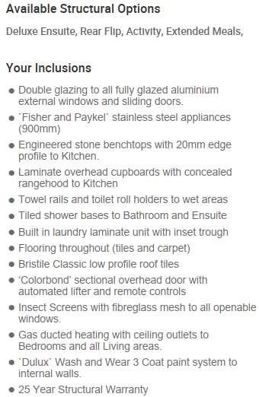
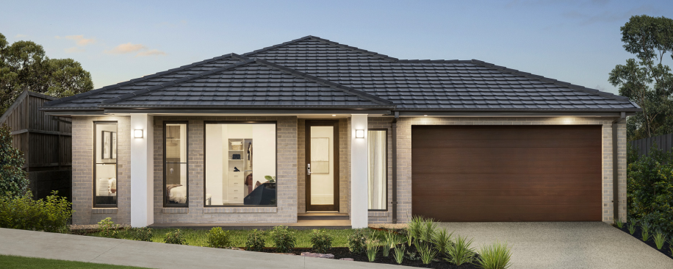
House and Land Package $853,500*
Bedroom 4 | Bathroom 2 | Garage 2
Somers 25
Lot 323 - Kingbird
Land Size: 448m²
Frontage: 14m
Builder: Beachwood Homes
Phone: 0409 449 841

